Slide 1


VITISH’23 HACKATHON

Slide 2
Team Enigma Decoders
Team Members:
Prathamesh R Potabatti – 20BAI1076
Chirag Chandrashekar – 20BAI1298
Gomathi L – 20BAI1013
Sneha Shankar – 20BAI1258
Bhuvaneshwari R – 20BAI1212
Jahnavi Thondepu – 20BAI1150

Slide 3

Problem Statement
Advanced ANPR & FRS solution
Design and develop a technological solution that can accurately perform the Automatic Number Plate Recognition (ANPR) along with Facial Recognition from the available CCTV feeds. The solution should be able to recognize number plates that are written in typical non-standard ways using varying font styles, sizes, designs, symbols, languages etc., i.e. difficult to recognize by existing ANPR Systems.

Slide 4
ABSTRACT
The main goal of this project is to implement an automatic number plate recognition system from a CCTV footage. From the CCTV video footage we have to extract the characters on the number plate of the ongoing cars. Another feature which we would be adding to this project is face recognition. We have to extract the number plate and the face of the driver and store the face image and the number plate as text in a backend database.

Slide 5
INTRODUCTION
There are multiple applications to an Automatic Number Plate Recognition system. This system can be implemented on tolls to capture the driver and the car details. This system can be used on speed cameras to detect if any driver is overspeeding and then capture his face and his car details. Huge parking lots can also use this system for better management of cars and keeping a record of who has entered and who has exited the parking lot along with the time stamps. Airports can also make use of this to manage their parking lots and charge the drivers according to their waiting times.

Slide 6
IMPLEMENTATION PROCEDURE
We will be using OCR algorithm to detect and record the number plate of the cars. We first have to train the Deep Learning model on a large datasets of car number plates. The dataset has to be augmented for better accuracy of the model. First, we focus on extracting the number plate, i.e., train the model to detect and draw a bounding box on the number plate. Then, we pass this to a Language processing model which uses LSTMs or Transformer based models to extract the textual content. Later, we will store this information into the database.

Slide 7
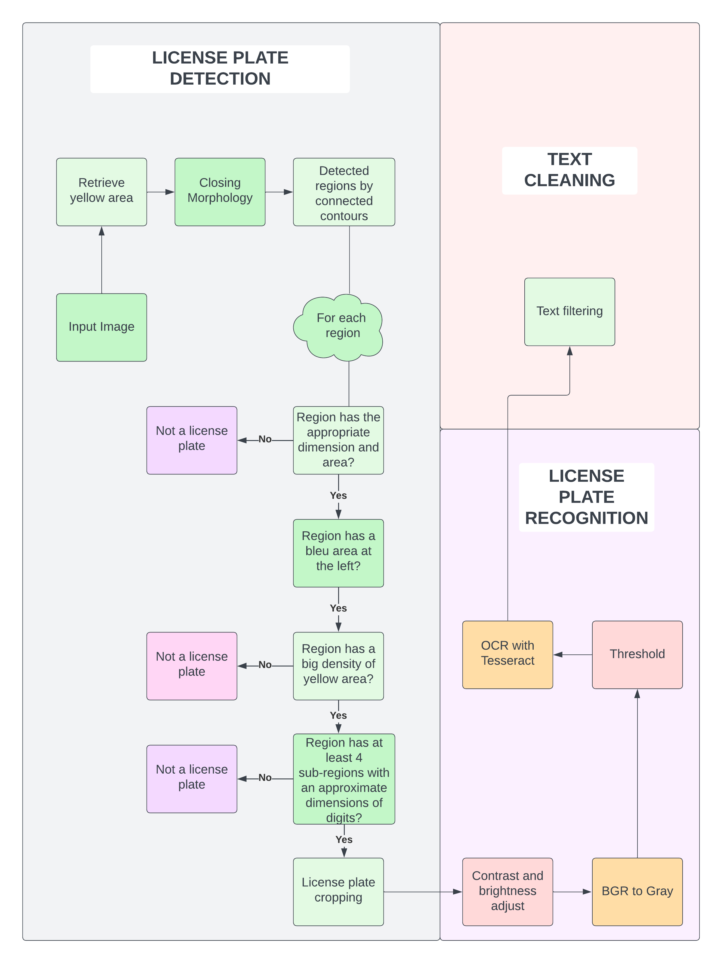

Slide 8
